Slide 1
Investment Appraisal
A set of tools which allow a company to make an informed decision on whether or not to proceed with a given investment.
These tools allow the company to understand the returns they can expect and compare different investments directly against each other.

Slide 2
Investment Appraisal
For A level Business, you need to be able to calculate and explain the value of:
Payback Period
Accounting (Average) Rate of Return
Net Present Value

Slide 3
Payback Period
Shows how long it will take to earn back the cost of an investment. Allows companies to compare which investment option will recoup its cost quickest and therefore potentially at a lower level of risk.

Slide 4
Payback Period
Year | Revenue ($)
0 | (500,000)
1 | 200,000
2 | 200,000
3 | 150,000
4 | 150,000
5 | 100,000
In this case the investment is shown in Year 0 as a negative number (in brackets) as it is an outflow of cash.
Each successive year shows the predicted earnings from the investment in that particular year.
So in Year 4, we expect to earn $150,000.

Slide 5
Payback Period
Year | Revenue ($)
0 | (500,000)
1 | 200,000
2 | 200,000
3 | 150,000
4 | 150,000
5 | 100,000
To calculate payback period, we first have to add up the cumulative income each year.

Slide 6
Payback Period
Year | Revenue ($) | Cumulative Revenue ($)
0 | (500,000) | (500,000)
1 | 200,000 | (300,000)
2 | 200,000 | (100,000)
3 | 150,000 | 50,000
4 | 150,000 | 200,000
5 | 100,000 | 300,000
By doing this, we can see that earnings cover costs at some point during Year 3, as this is the first year that cumulative revenue is positive.

Slide 7
Payback Period
Year | Revenue ($) | Cumulative Revenue ($)
0 | (500,000) | (500,000)
1 | 200,000 | (300,000)
2 | 200,000 | (100,000)
3 | 150,000 | 50,000
4 | 150,000 | 200,000
5 | 100,000 | 300,000
To calculate a specific answer, we now we divide the earnings in Year 3 by 365 to work out how much is earned per day.
150,000 = $410.96
365

Slide 8
Payback Period
Year | Revenue ($) | Cumulative Revenue ($)
0 | (500,000) | (500,000)
1 | 200,000 | (300,000)
2 | 200,000 | (100,000)
3 | 150,000 | 50,000
4 | 150,000 | 200,000
5 | 100,000 | 300,000
Now we simply divide the amount still needed to cover costs, in this case $100,000, by the amount earned per day.
100,000 = 243 days
410.96

Slide 9
Payback Period
Year | Revenue ($) | Cumulative Revenue ($)
0 | (500,000) | (500,000)
1 | 200,000 | (300,000)
2 | 200,000 | (100,000)
3 | 150,000 | 50,000
4 | 150,000 | 200,000
5 | 100,000 | 300,000
So our answer is that payback period is equal to 2 years and 243 days.

Slide 10
Payback Period
Year | Revenue ($)
0 | (1,281,000)
1 | 515,400
2 | 375,000
3 | 261,400
4 | 181,500
5 | 135,100
Year | Revenue ($)
0 | (760,000)
1 | 275,000
2 | 225,000
3 | 195,000
4 | 135,000
5 | 95,000
Calculate the Payback Period for these 2 examples

Slide 11
Payback Period
What does this show us?
On its own, we can simply see how long the investment would take to recover costs.
As with all the methods we will learn, this is only significantly useful when compared with another investment option.

Slide 12
Net Present Value
A method of investment appraisal which allows us to compare the earnings we could achieve from a business investment relative to the amount we could earn if money was invested in a less risky alternative.

Slide 13
Net Present Value
The difference between the present value of the future cash flows from an investment and the amount of investment. Present value of the expected cash flows is computed by discounting them at the required rate of return.
The value of money decreases over time because of the effects of inflation. As products become more expensive, the same amount of money will buy fewer products, therefore that money is less valuable.
Companies also have the option of keeping money in a bank or buying bonds and earning interest. This is a much less risky way of earning money than through a business venture.

Slide 14
Net Present Value
For example, an investment of $1,000 today at 10 percent will yield $1,100 at the end of the year; therefore the present value of $1,100 earned 1 year from now is $1,000.
The amount of investment ($1,000 in this example) is deducted from this figure to arrive at net present value which here is zero ($1,000-$1,000). A zero net present value means the project repays original investment plus the required rate of return.
A positive net present value means a better return, and a negative net present value means a worse return, than the return from zero net present value.

Slide 15
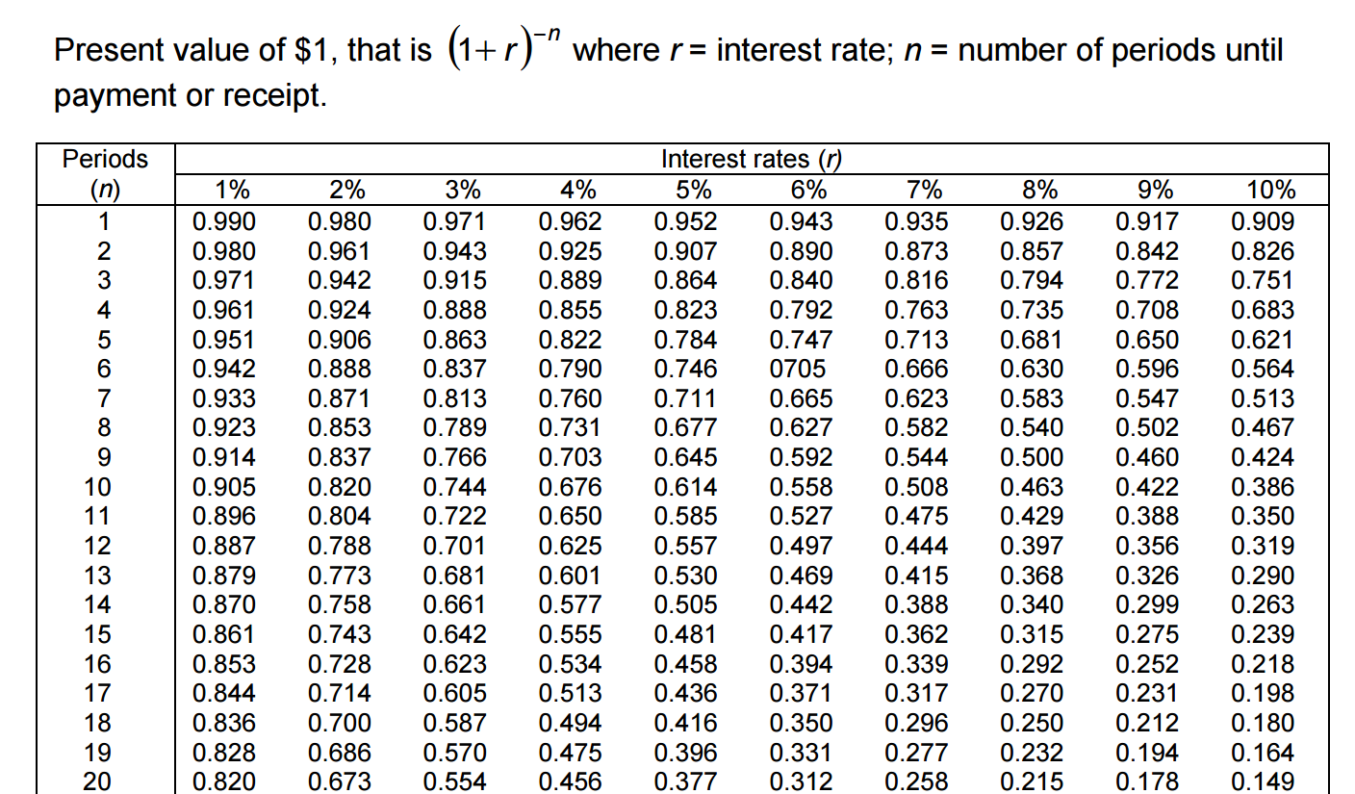
Net Present Value

Slide 16
Example
Year | Revenue ($)
0 | (500,000)
1 | 200,000
2 | 200,000
3 | 150,000
4 | 150,000
5 | 100,000
Year | Discount Value | Calculation | Present Value
1 | 0.9615 | 0.9615 x 200,000 | $192,300
2 | 0.9246 | 0.9246 x 200,000 | $184,920
3 | 0.8890 | 0.8890 x 150,000 | $133,350
4 | 0.8548 | 0.8548 x 150,000 | $128,220
5 | 0.8219 | 0.8219 X 100,000 | $82,190
Total Present Value minus Initial Investment = Net Present Value
$192,300 + $184,920 + $133,350 + $128,220 + $82,190 - $500,000 = $220,890
Calculate the net present value at a discount rate of 4%

Slide 17
Net Present Value
Calculate the net present value at a discount rate of
4%
6%
8%
10%
20%
Year | Revenue ($)
0 | (760,000)
1 | 275,000
2 | 225,000
3 | 195,000
4 | 135,000
5 | 95,000

Slide 18
Net Present Value
Calculate the net present value at a discount rate of
4%
6%
8%
10%
20%
Year | Revenue ($)
0 | (1,281,000)
1 | 515,400
2 | 375,000
3 | 261,400
4 | 181,500
5 | 135,100

Slide 19
Accounting Rate of Return
ARR shows the average amount of profit earned per year through an investment, expressed as a percentage.
It is useful in comparing returns on investment to returns on other investments, savings and bonds as the percentage result is very easy to compare.

Slide 20
Accounting Rate of Return
To calculate ARR, first we need to add up total net cashflow, which is dones by adding all of the predicted profit figures and subtracting the cost of the initial investment.
In this case, the total would be $300,000
Year | Revenue ($)
0 | (500,000)
1 | 200,000
2 | 200,000
3 | 150,000
4 | 150,000
5 | 100,000

Slide 21
Accounting Rate of Return
We then need to calculate the average amount of profit earned per year.
We do this by dividing the profit by the number of years the investment is planned to cover.
$300,000 = $60,000
5
Year | Revenue ($)
0 | (500,000)
1 | 200,000
2 | 200,000
3 | 150,000
4 | 150,000
5 | 100,000

Slide 22
Accounting Rate of Return
The final step is to calculate this profit per year as a percentage of the initial investment.
We do this by dividing the amount earned per year by the initial investment.
$60,000 = 0.12
$500,000
Year | Revenue ($)
0 | (500,000)
1 | 200,000
2 | 200,000
3 | 150,000
4 | 150,000
5 | 100,000

Slide 23
Accounting Rate of Return
Finally we multiply this by 100 to give a percentage answer.
0.12 x 100 = 12%
So we can see that this investment is predicted to return 12% of its cost in profits each year. This is significantly higher than what could be earned in a bank so could be a viable option.
Year | Revenue ($)
0 | (500,000)
1 | 200,000
2 | 200,000
3 | 150,000
4 | 150,000
5 | 100,000

Slide 24
Accounting Rate of Return
Year | Revenue ($)
0 | (1,281,000)
1 | 515,400
2 | 375,000
3 | 261,400
4 | 181,500
5 | 135,100
Year | Revenue ($)
0 | (760,000)
1 | 275,000
2 | 225,000
3 | 195,000
4 | 135,000
5 | 95,000
Calculate the ARR for these 2 examples

